Slide 1
Charles de Gaulle
—— The man who I admire most.

Slide 2
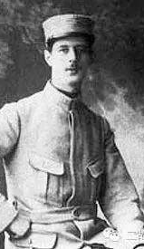
Charles de Gaulle （1890-1970）
Army and France are the key words in Charles de Gaulle’s life.
Before the Second World War
During the Second World War
After the Second World War

Slide 3
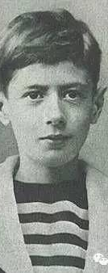
Before the Second World War
In childhood:
Aggressive and patriotic.
Saint-Cyr military academy
Join in the First World War in 1913
Make friends with Petain

Slide 4
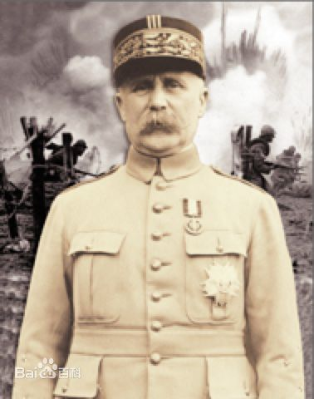
Before the Second World War
Aggressive
Do a lot of research about armor
Unpopular
Failed to get on well with colleagues.
Lucky
Petain
Charles de Gaulle’s superior.
Appreciate.

Slide 5
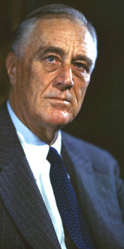
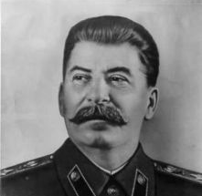
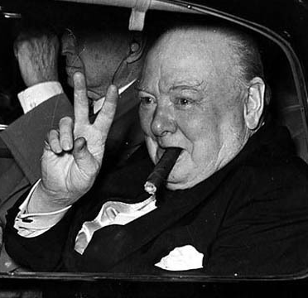
During the Second World War
England
The Soviet union's war against German
America

Slide 6
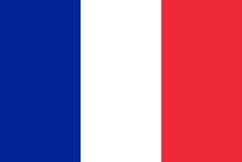
During the Second World War
?
So, where was France?
The government ruled by Petain announce to surrender.
The friendship broke up.

Slide 7

During the Second World War
He went to London and set up an army called free French.
Call on people to keep fighting.
He tried to save his homeland.

Slide 8
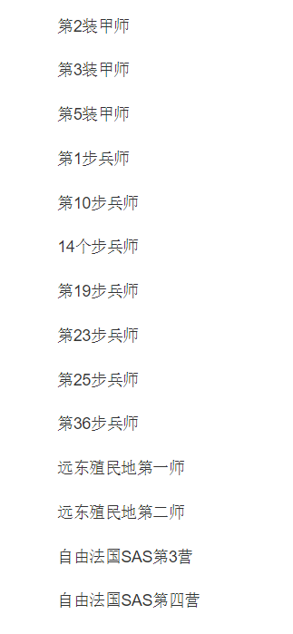
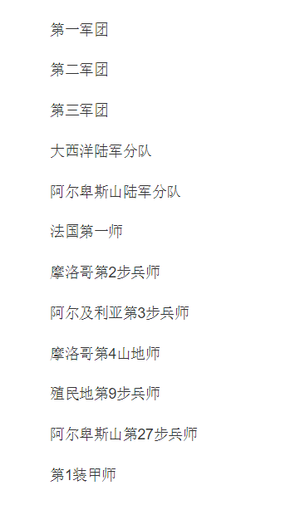
free French
It was only Recognized by Britain and its colony.
.
At first, only 200 soldier who had retreated from Dunkerque join the free French.
Until 1945…

Slide 9
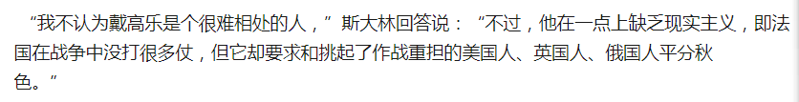
After the Second World War
He fought for French sovereignty, try to keep the position of Fence during the America, Britain, and the Soviet Union.

Slide 10
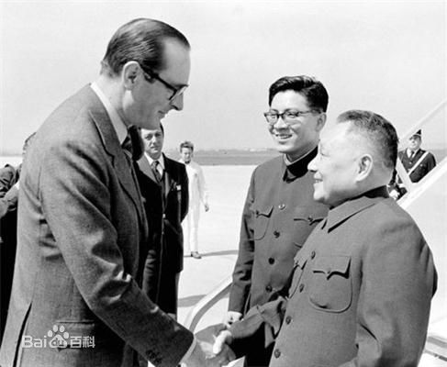
After the Second World War
He reformed the Constitution, and become the first president The Fifth Republic of France.
France is the first western country which establish the diplomatic relations with China.

Slide 11
My views
In the army, he struggle to save his country and fight in determination.
But for France, he has a opposite views against which is popular in army, such as infancy of Empire.
He is a excellent leader, who focus on the economic development and national democracy, but his private power.

